Slide 1


C841 (IHP4) Getting Started
Topics Covered:
How to access the course material.
How to access the task requirements, rubric, and case study.
How to submit your work.

Slide 2
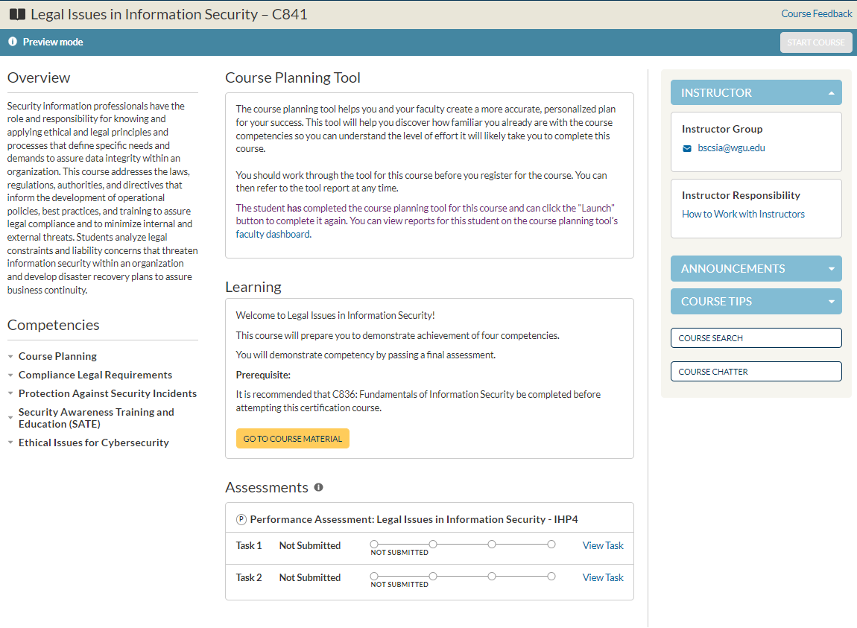
Click here to access your course materials.

Slide 3
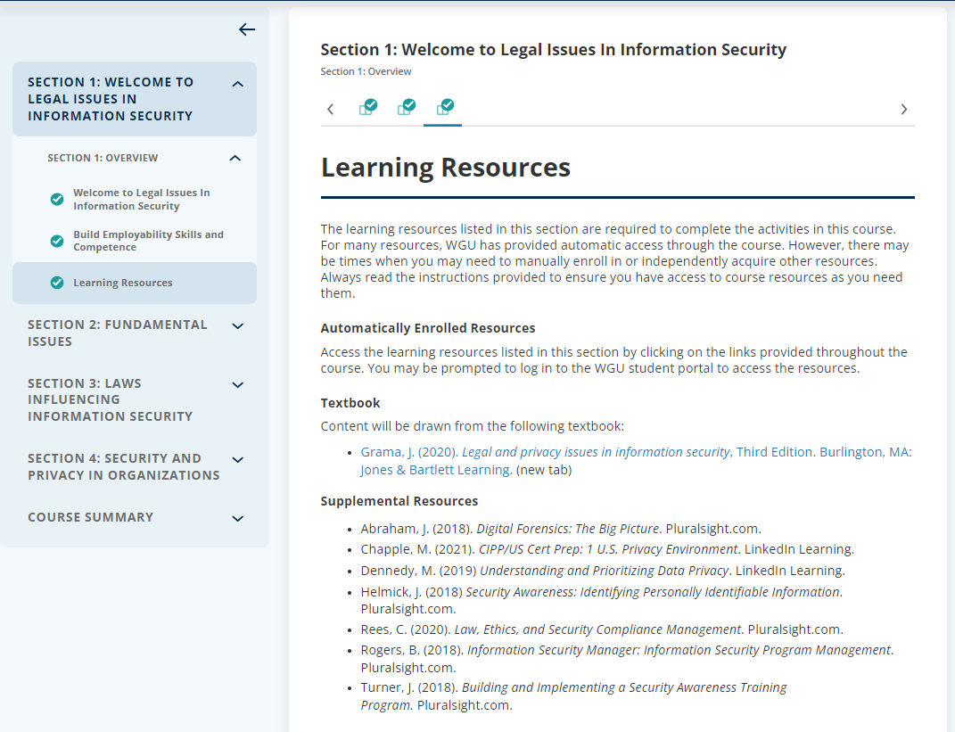
Start working through the text and videos here. The textbook in e-book view is available via the link below.

Slide 4

The e-book layout allow you to scroll through the text and also provides some print and download options above.

Slide 5
You can access the requirements, rubric, and case study for the tasks by clicking the respective task link. Note, the case study is the same for both tasks.

Slide 6
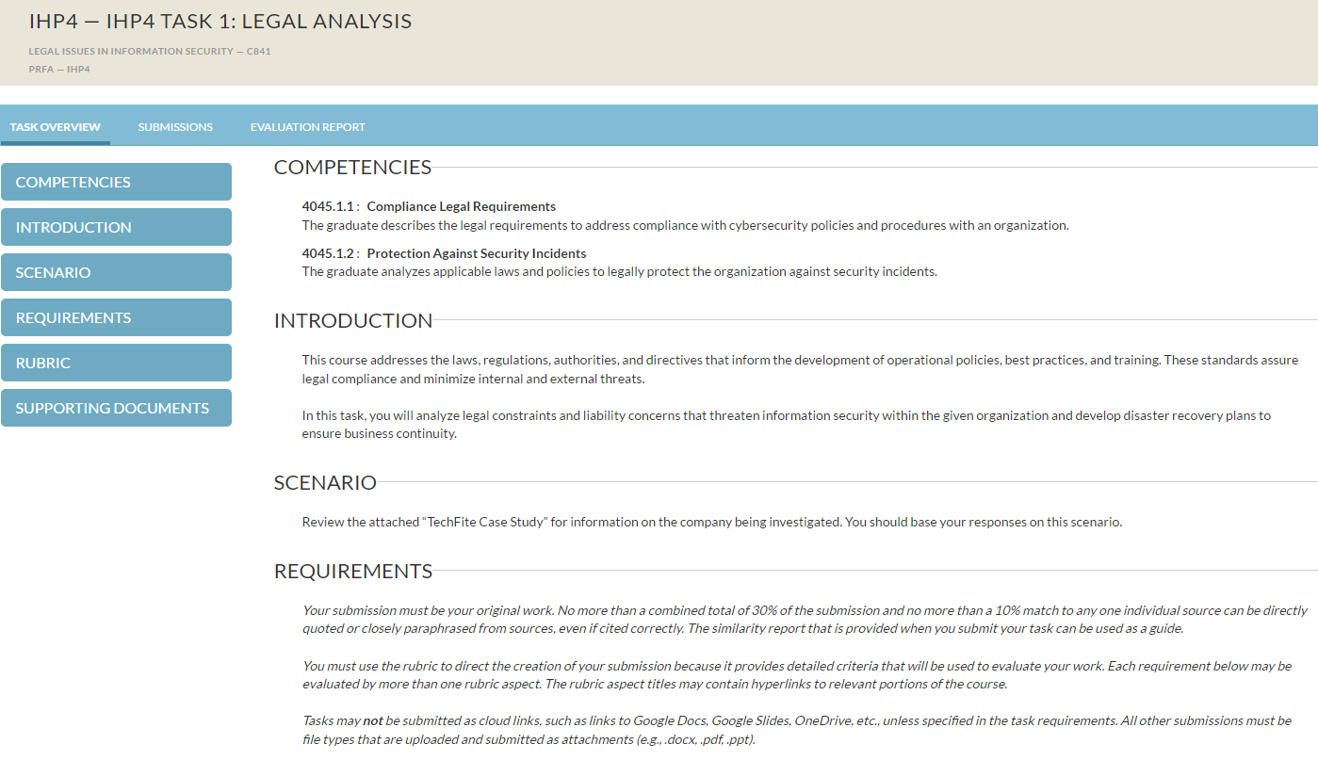
From the ”Task Overview” tab, you can access the task requirements, rubric, and case study using the menu to the left which scrolls the page as you click options. The case study is located in the “Supporting Documents” section at the bottom of the page.

Slide 7
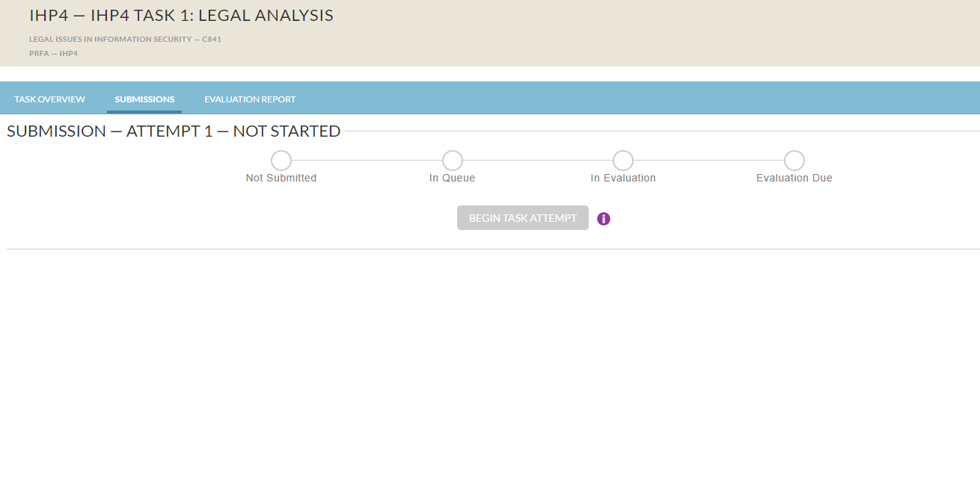
When you’re ready to turn your work in for evaluation, navigate to the “Submissions” tab above and then click the ”Begin Task Attempt” button and follow the prompts to upload, run your similarity check*, and finally submit. Once you submit, your timeline will go active with updates and an “Evaluation Due” date will be established and displayed for a date 72 hours from your submission timestamp.
*Check originality prior to submitting: *Video on Reviewing Unicheck Reports- will walk you through checking originality before submitting your task. Be sure to hit the refresh button on your browser, in order to see the originality score prior to hitting the submit button. It normally takes around 10-20 minutes for a score to appear. It can take up to 24 hours in extreme circumstances.

Slide 8
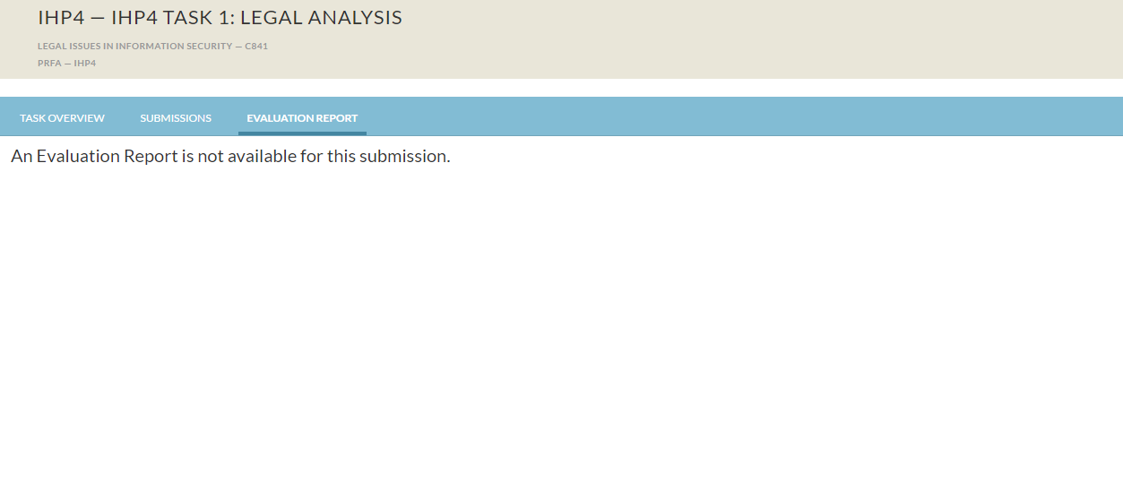
Once your evaluation has been completed, navigate to the “Evaluation Report” tab. Your results will be located here.

